Slide 1
CAP Twelve Years Later: How the “Rules” Have Change
Author : Eric Brewer, University of California, Berkeley
Presenters :
Hitesh Kumar
Saurav Mohanty
October 23rd 2025

Slide 2
Introduction
Re-evaluation of the CAP theorem of 12 years.
During a network partition, a distributed system can provide at most two of the three guarantees.
Clarify what CAP says and doesn’t say.
To show that it’s not about “choosing two,” but rather about how systems behave during partitions.
To introduce practical strategies for balancing C, A, and P in real-world designs.

Slide 3
ACID vs BASE vs CAP
Aspect | ACID (Traditional Databases) | BASE (High Availability Systems) | CAP Relationship / Notes
Full Form | A – Atomicity C – Consistency I – Isolation D – Durability | B – Basically Available S – Soft State E – Eventually Consistent | C – Consistency A – Availability P – Partition Tolerance
Atomicity (A) | Transactions are all-or-nothing; simplifies recovery | Atomic operations still desirable locally for stability | Atomicity helps both sides of a partition recover consistently
Consistency (C) | Ensures all database rules (e.g., unique keys, referential integrity) hold | Temporary inconsistencies allowed; data converges over time | CAP’s C = single-copy consistency, a subset of ACID’s consistency
Notes:
Philosophy
Focuses on strong consistency and correctness
Emphasizes availability and fault tolerance over immediate consistency
Represent opposite ends of the consistency–availability spectrum
Origin
Long-established approach for relational databases
Coined in late 1990s to describe new design trends for distributed systems
CAP explains the trade-offs between consistency and availability

Slide 4
ACID vs BASE vs CAP
Isolation (I) | Transactions execute as if serially ordered | Weaker isolation; may allow concurrent updates with compensation later | Isolation breaks during partitions → only one side can operate
Durability (D) | Once committed, data is permanent | May avoid strict durability via soft state to reduce cost | Durable operations might need reversal if invariants are violated during partition
Eventual Consistency | Not supported — consistency is immediate | Fundamental principle; all replicas converge eventually | Enables high availability under partitions
Partition Handling | Cannot maintain ACID guarantees during network partitions | Designed to continue operation even when partitions occur | Partition recovery reconciles states and restores consistency
Notes:
Modern Relevance
Used in critical, transactional systems (e.g., banking)
Used in large-scale, distributed cloud systems
Modern systems often mix ACID and BASE techniques

Slide 5
CAP Theorem
System can have at most two of three desirable properties:
Consistency (C)
High availability (A)
Tolerance to network partitions (P)

Slide 6
CAP Theorem
The Inevitable Trade-off
Since a system must have P, its designers are forced to choose between C (Consistency) and A (Availability) during a network partition.
Choice | Implication | System Behavior
P + C | Forfeit A | If a node cannot contact the primary source of truth (due to the partition), it must refuse to process a request (or throw an error) to ensure data integrity.
P + A | Forfeit C | If a node cannot contact the primary source of truth, it must continue to process requests (writes and reads) locally to remain available. This may lead to stale or conflicting data being served until the partition heals.
Notes:
Amazon -> AP ( always to cart )
Bank -> CP ( you don’t withdraw )

Slide 7
CAP Confusion
The “2 of 3” slogan is too simplistic : Partitions should be treated as special, temporary events, not as the normal operating state.
Partitions are rare, not constant.
“Consistency” and “Availability” aren’t binary.
Partition tolerance isn’t optional.
The real question is: what happens during a partition?
CAP is not a design algorithm, it’s a thinking framework.

Slide 8
Examples
Example 1 : Shopping Cart | Example 2 : Banking
During a partition, do you stop customers from checking out (consistent but unavailable)? Or let them continue and fix inconsistencies later (available but not perfectly consistent)? Amazon choses the second — eventual consistency. | During a partition, you must stop withdrawals from disconnected branches. That’s a CP choice — sacrificing availability for safety.
Notes:
Amazon -> AP ( always to cart )
Bank -> CP ( you don’t withdraw )

Slide 9
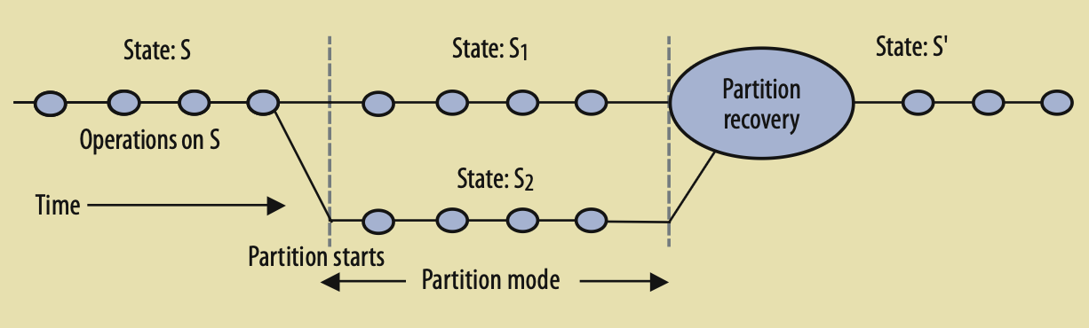
Managing Partitions
Step | Description
1. Detect the partition | System realizes that communication between nodes is broken (after timeout).
2. Enter partition mode | System temporarily changes how it operates — may restrict certain operations or record extra info.
3. Recover when reconnected | When network is restored, system reconciles differences and restores consistency.
Notes:
Partition is basically when nodes can’t communicate with each other
How do system enters partition mode
What do systems do -> add some extra info, restrict some operations
Based on the design , it will reconcile after the partition and restore consistency. ( using version vectors, sets )
In the last step, the system initiates a partition recovery.
The state starts out consistent and remains so until a partition starts. To stay
available, both sides enter partition mode and continue to execute operations, creat-
ing concurrent states S1 and S2, which are inconsistent. When the partition ends, the
truth becomes clear and partition recovery starts. During recovery, the system merges
S1 and S2 into a consistent state S' and also compensates for any mistakes made during
the partition.

Slide 10
Partition Recovery
Two Main Recovery Challenges : 1. Consistency 2. Compensation
Some systems can’t automatically resolve all conflicts.
Commutative Replicated Data Types (CRDTs)
Amazon’s shopping cart — when the partition heals, the final cart is the union of both sides’ items (so deleted items might reappear)
CRDTs ensure: Commutative property, every update moves upward on a lattice, Advanced CRDTs even allow adds and deletes using two internal sets.

Slide 11
CRDTs - Commutative
Scenario | Replica 1 (Node A) | Replica 2 (Node B) | Final Merge
Initial Value | Counter $C = 5$ | Counter $C = 5$ | N/A
Concurrent Updates | $A$: Increment C by $1 -> 6$ | B: Add $3 to C -> $8
Update Order on Merge | Applies $A$ then $B$: $5 -> {1} + 6 -> 6 + {3} -> {9}$ | Applies $B$ then $A$: $5 -> 5 + {3} -> 8 + {1} -> {9}$ | 9
Conclusion | The final value is $9$, regardless of which replica's update was applied first. The operations commute.

Slide 12
CRDTs – Upward Lattice & Sets
Once operations are observed and applied by a replica, the object's state will always take into consideration that operation.
Once an operation is applied, it will never be un-applied.
“Deleting” something doesn’t erase history; it adds a new event saying, ‘this item was deleted’. The full system state is still larger than before — it knows more, not less.
More advanced CRDTs can handle both additions and deletions safely — by internally tracking which elements were added and which were removed.
Notes:
Advanced CRDTs can be used in case of Amazon shopping cart where add and delete is useful.
The total number of operations after the reconciliation is greater than or equal to the number of operations before partition.

Slide 13
Compensating for mistakes
When the partition heals, the system must fix those mistakes : this process is called compensation — restoring correctness and user trust.
During partition mode, the system keeps a log of all actions that might have broken rules which are called invariants.
Example invariants:
“A flight cannot have more passengers than seats.”
“A bank account balance can’t go below zero.”
Notes:
The list of operations which can break the rules are called invariants

Slide 14
Compensating for mistakes
Analogy — Understanding Externalized Mistakes : 🍺 + 📞
Even if you delete the calls from your phone, your ex/boss still remembers.
Likewise, in distributed systems, once an operation is externalized — you can’t just roll it back, you must compensate for it.

Slide 15
Compensating for mistakes
Strategy | Description | Example
Last writer wins | Keep the latest change, ignore older ones | Latest profile update overwrites older ones
Merge operations | Combine both changes | Merge two shopping carts
Human escalation | Ask a person to fix conflicts | Airline staff reassigns seats for overbooked passengers
Automated compensation | Undo or repair externalized effects | Refund a duplicate charge
Notes:
After compensation:
The final state of the system ≈ what it would have been if the mistake never happened.
Even if that means doing refunds, sending apologies, or giving discounts — the outcome should feel equivalent.
This idea leads to a formal concept from databases: Sagas.
A Saga = one large transaction broken into smaller steps (subtransactions). Each subtransaction commits independently, but if something goes wrong later, a compensating transaction reverses it.
Example (Payroll Update Saga):
✅ Update employee salary.
✅ Send paycheck.
❌ Company realizes a mistake — now run compensation:
Revert salary entry.
Deduct overpaid amount next cycle.
Goal: Avoid cascading aborts (don’t undo every transaction that depended on the bad one).

Slide 16
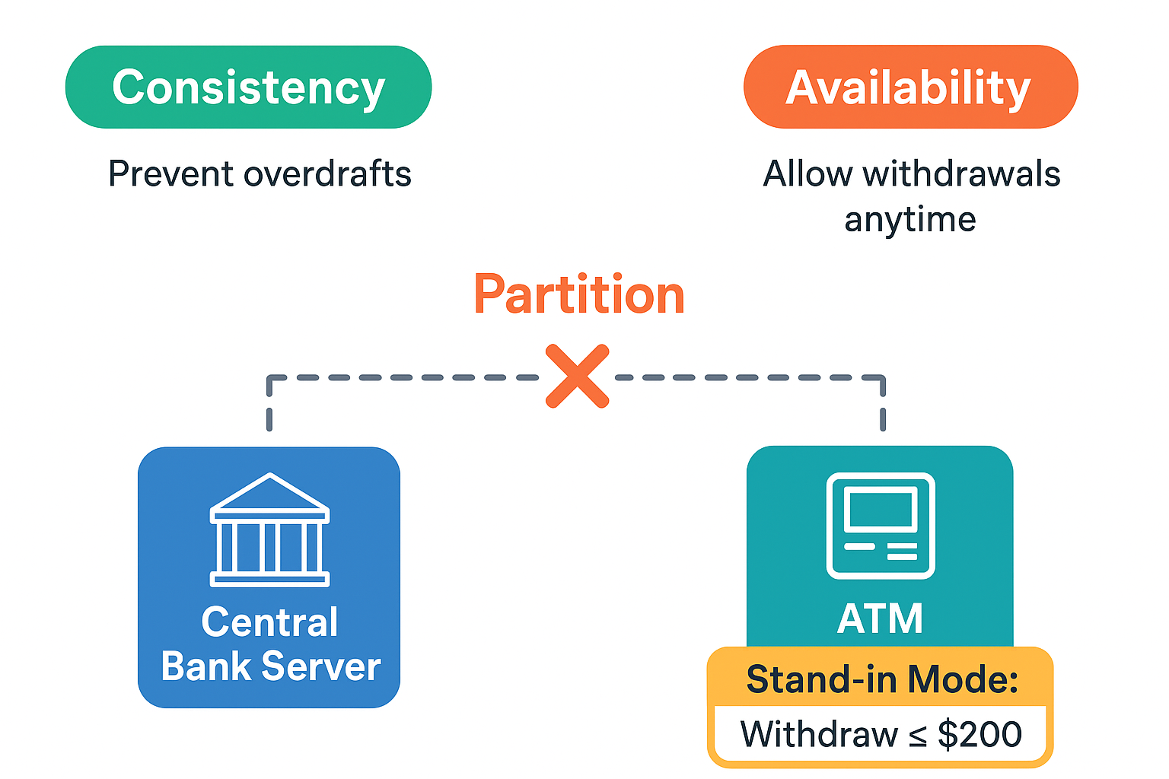
How do Real Systems Cope ?
Compensation issues in an Automated Teller Machine (ATM)
Balance can’t be less than 0.
Modern ATMs use a bounded compromise called “stand-in mode”.
This limits the withdrawal to $200.
Operation | Can violate invariant?
Deposit | ❌ No
Check Balance | ❌ No
Withdraw | ✅ Yes
Notes:
Bounded inconsistency: It’s acceptable as long as the “damage” is limited and recoverable.
Compensation mechanisms: Legal, financial, or operational corrections are used later.
Human tolerance for eventual correction: Customers may pay overdraft fees later — this is eventual consistency in finance.
Check Kiting” — The Extreme Example
The paper mentions check kiting, a fraud tactic exploiting partitions:
A customer writes checks or withdraws money from multiple branches before they sync, effectively spending the same money twice.
Eventually, when systems sync:
The overdraft is detected.
Compensation = legal action, not data rollback.
💬 This shows that:
Even when consistency fails temporarily, humans and institutions compensate via non-technical means.

Slide 17
Conclusion
System designers should not blindly sacrifice consistency or availability when partitions exist.
Using the proposed approach, they can optimize both properties through careful management of invariants during partitions.
“CAP is not about choosing what you lose — it’s about understanding what you’re willing to give up, and for how long.”
Strong systems are not the ones that avoid partitions — they are the ones that handle them gracefully.
Notes:
“Brewer’s CAP theorem taught us that distributed systems live in a world of trade-offs — and the best engineers aren’t those who avoid them, but those who design intelligently around them.”

